Slide 1

CAP777 – WEB DEVELOPMENT USING PHP CA - 4 (Yoga event Registration website)
Submitted by
(Ankit Kumar Soni) – (12113094)
(Ankit Kumar Mishra) – (12113075)

Slide 2
Table of contents
Introduction to the Project
Scope of the Project
Features of the website
Modules/ Functionalities of the Project
Structure of the Back End (Database & Tables)
Conclusion
Limitation

Slide 3
Introduction to the Project
The Yoga Event Registration website is a platform for people to find and register for yoga events happening in their area. The website offers a variety of features that allow users to search for yoga events by keyword,of location, or date. Users can also create and manage their own events. This website is designed for people to register for yoga events.

Slide 4
Scope of the Project
We have created a yoga registration website for events. From the admin panel, users can add yoga events and information about them. The information will be stored in the database and the visitors of the website will be able to search for events and view the details.
We can use this project for yoga event which is happen in universities.

Slide 5
We can use this project for yoga event which is happen in Government offices.
We can use this project for yoga event which is happen in Private Sector or Public Sector.

Slide 6
Features of the website:
Admin can add yoga events and information about them.
The information will be stored in the database.
Users can find notification for yoga events and view the details.
User can easily contact to the admin through contact us form.
User can easily ask his query regarding yoga event places.

Slide 7
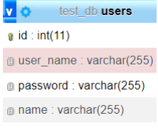
Modules/ Functionalities of the Project
Admin Register and login:
In this module admin can easily register himself, after registering admin has been able to login for admin panel.

Slide 8
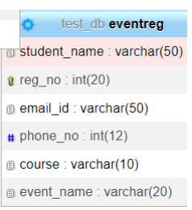
Event Registration:
In this module students will be able to register himself by registration page which is visible in front of the website.

Slide 9
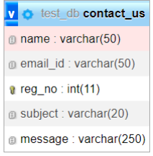
Contact us:
In this module students will be able to contact to admin by filling contact us page which is visible in front of the website

Slide 10
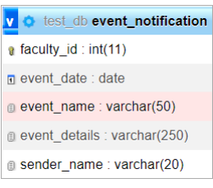
Notification:
In this module admin will be send notification to students regarding which is visible in admin panel of the website.

Slide 11
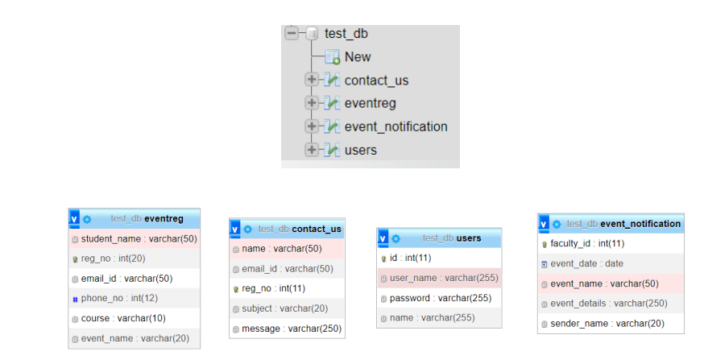
Structure of the Back End (Database & Tables)

Slide 12
Conclusion
The yoga Event Registration website has been completed and is now up and running. The website allows users to register for yoga events and view information about upcoming yoga events. The website also allows administrators to manage event information and registrations.

Slide 13
THANK YOU

